Slide 1

Mid-Bootcamp Project- Villarreal Club de Fútbol
Alo Askari

Slide 2

The question and the data
Question: How has the number of “homegrown” players changed over time and how has it impacted performance on the pitch and in the transfer market
Originally various Excel files-
“Df”- team data, information and individual statistics for every player to play for Villarreal since the 1995-1996 season e.g. starting appearances
“Df_averages”- team averages for each season, based on the data provided in df e.g. average minutes played
“Df_european_comps”- information and statistics for every cup competition they’ve played in they’ve gone on e.g. round of tournament
“Df_goals”- statistics for goals scored and conceded (as a team) for each season, a valuable KPI e.g. goal difference (net goals)
Cleaned and eventually merged the data frames together into a “master_df”
Applied various functions to clean it and make it make sense

Slide 3
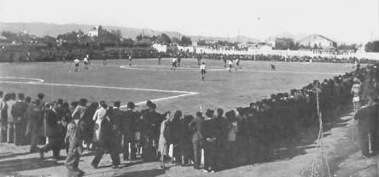
Population of Villarreal relative to rest of Spanish cities with a top-flight club

Slide 4
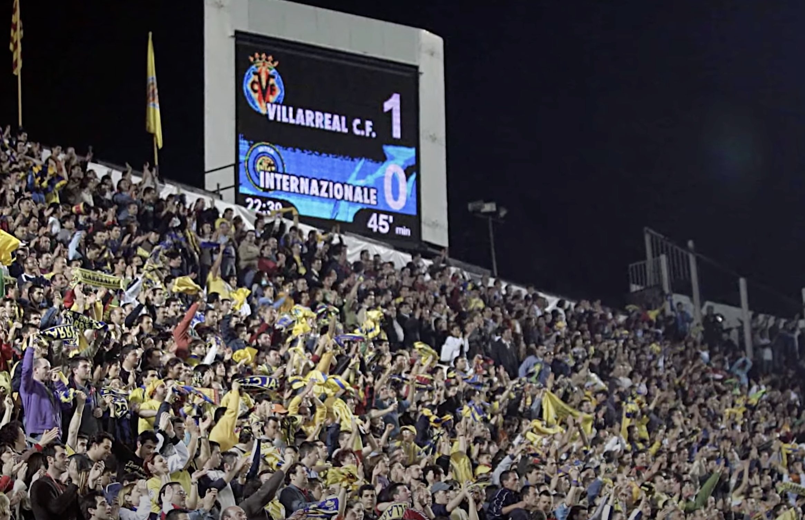
Population of Villarreal relative to cities competing in 2021/2022 Champions League

Slide 5
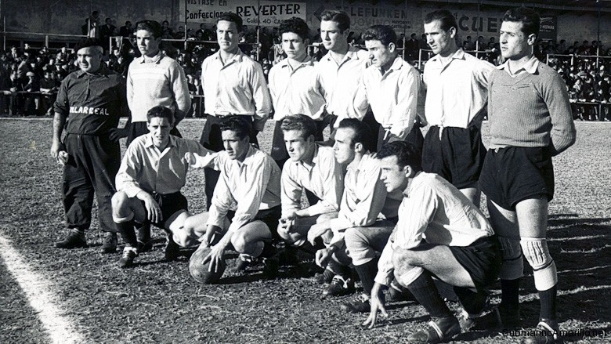
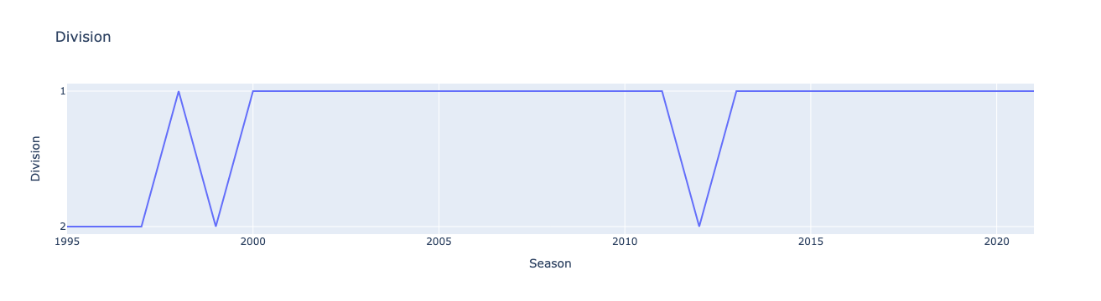
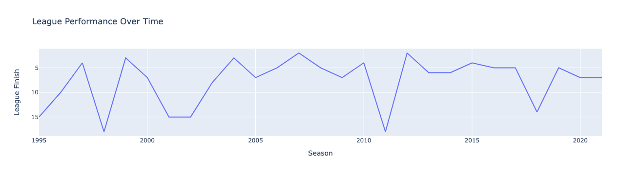
League Performance (1995-2022)

Slide 6
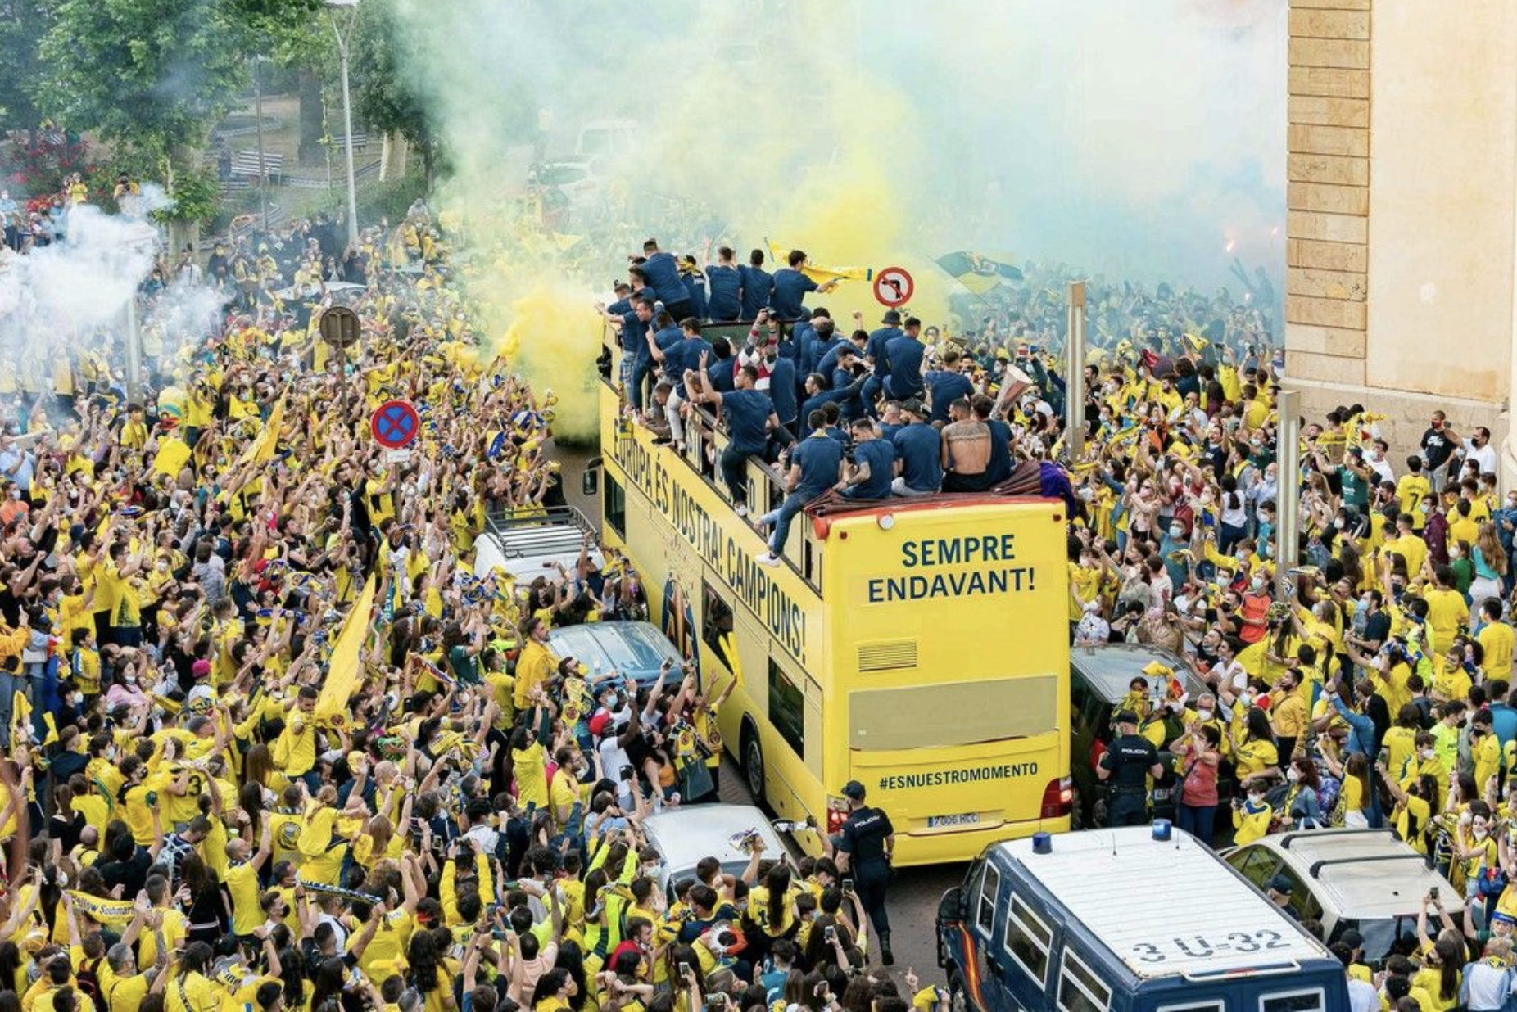
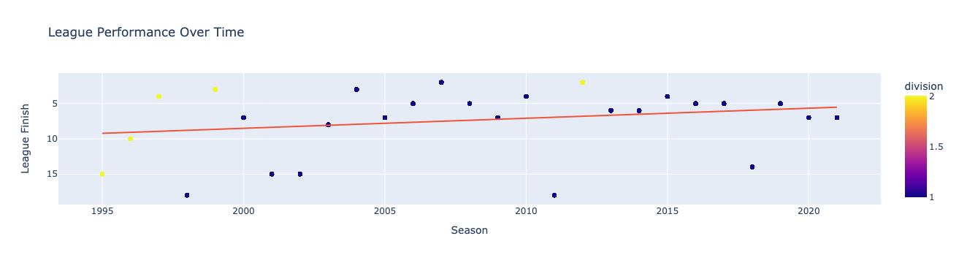
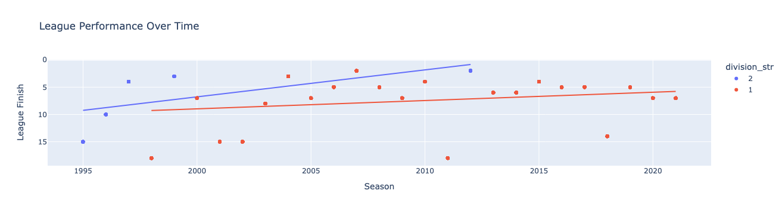
League Performance- By Division

Slide 7
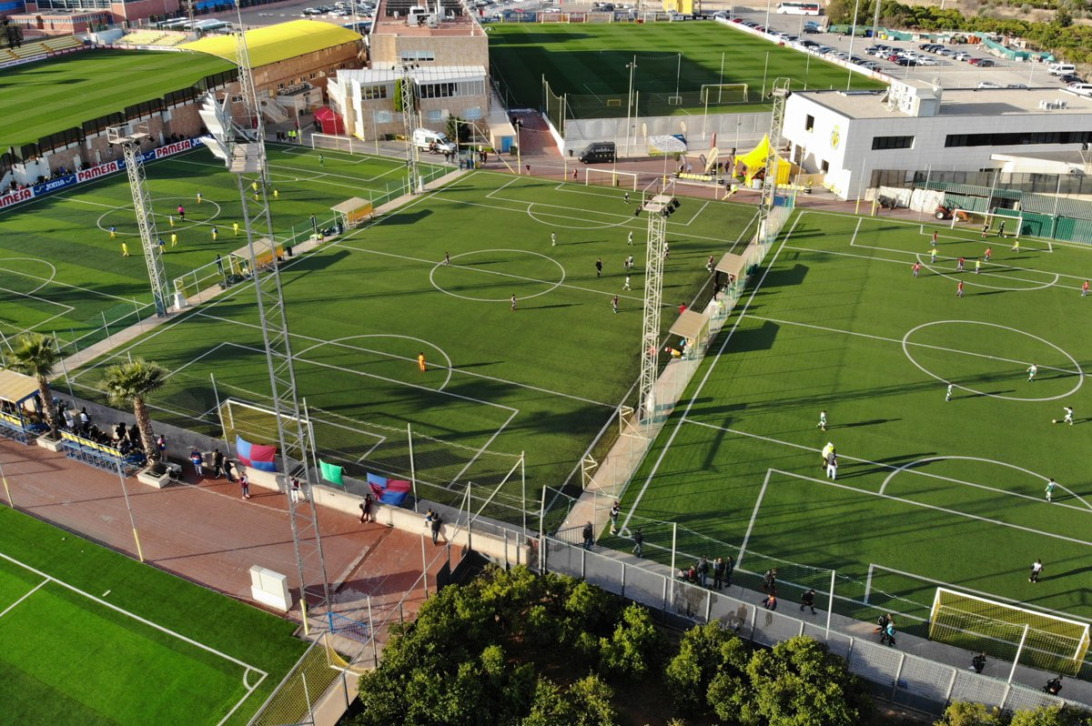
Homegrown Players

Slide 8

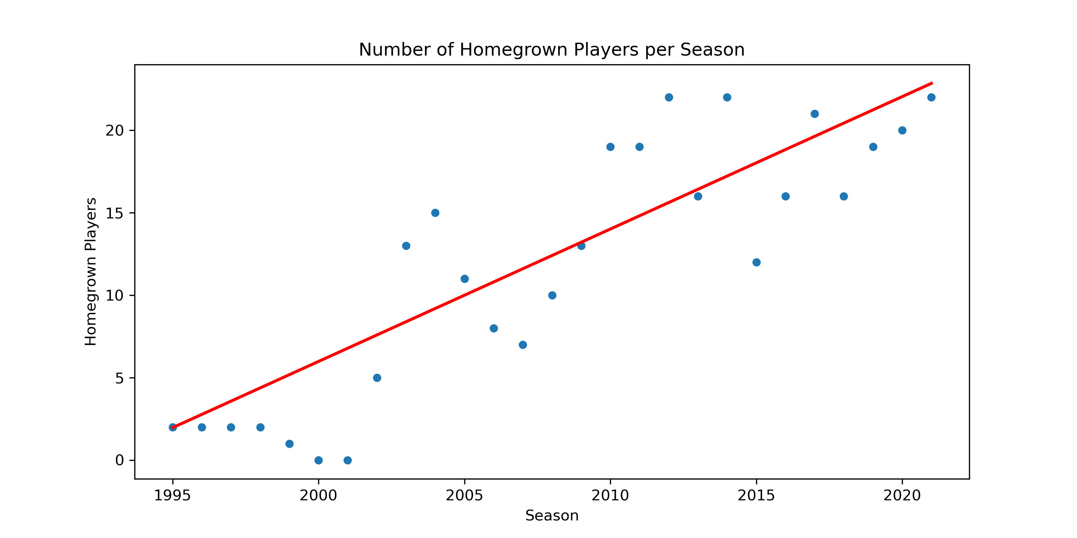

Slide 9

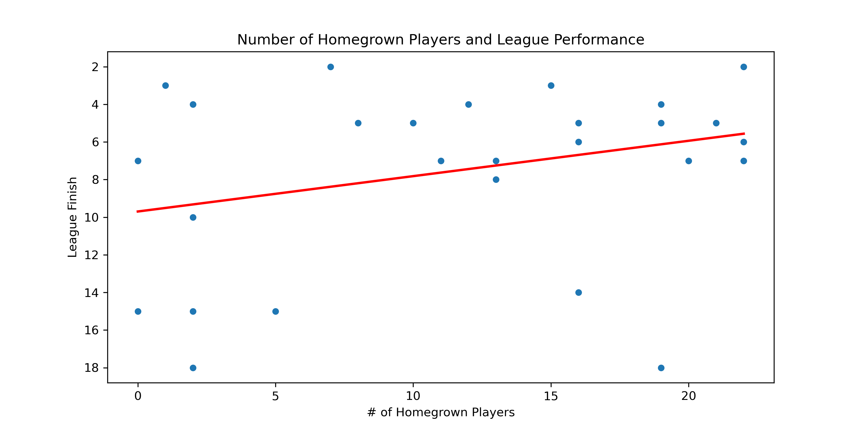

Slide 10

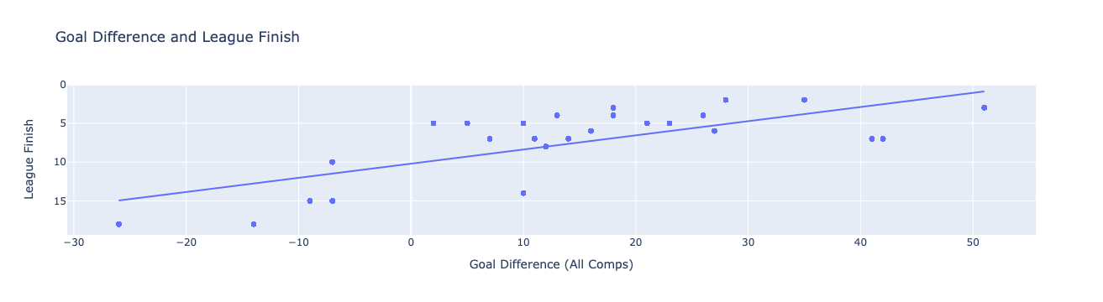
Goal Difference and League Performance

Slide 11

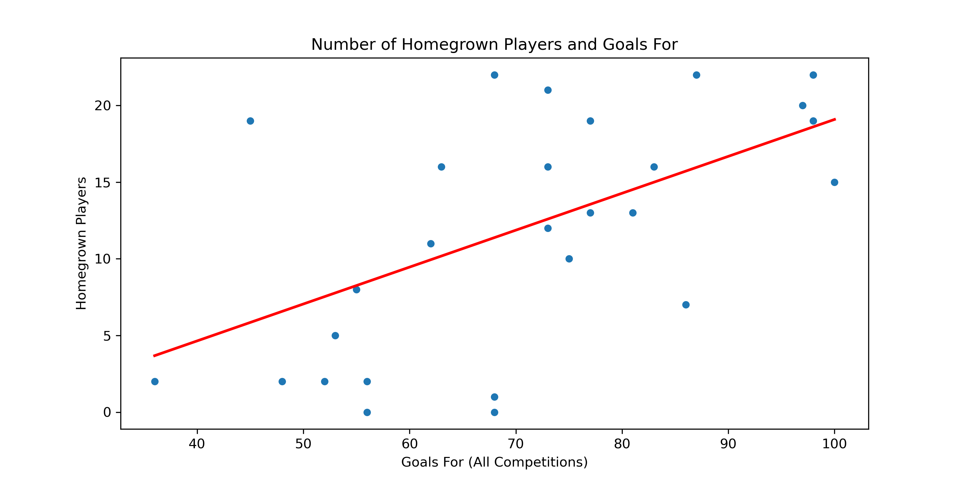
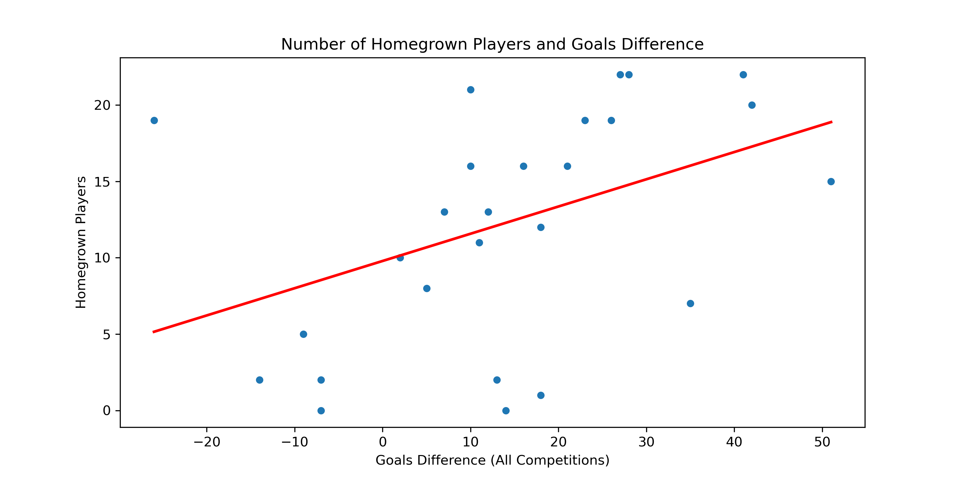
Goal Difference and Homegrown Players

Slide 12

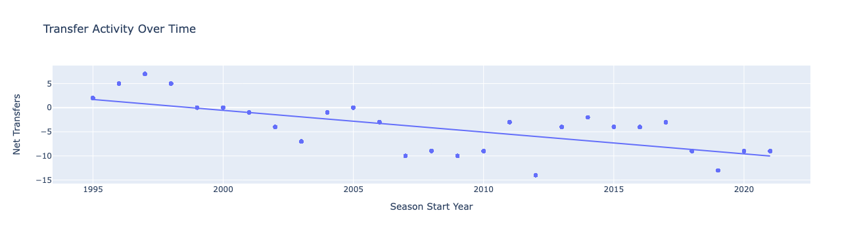
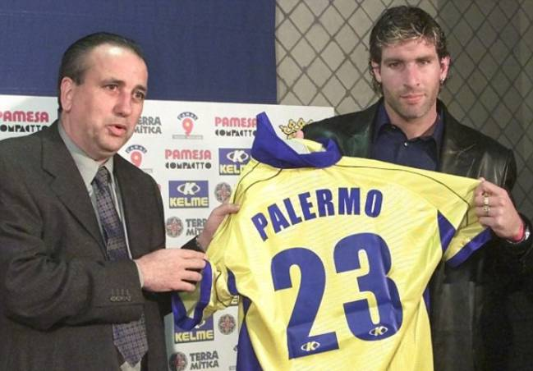
Transfer Activity Over Time

Slide 13

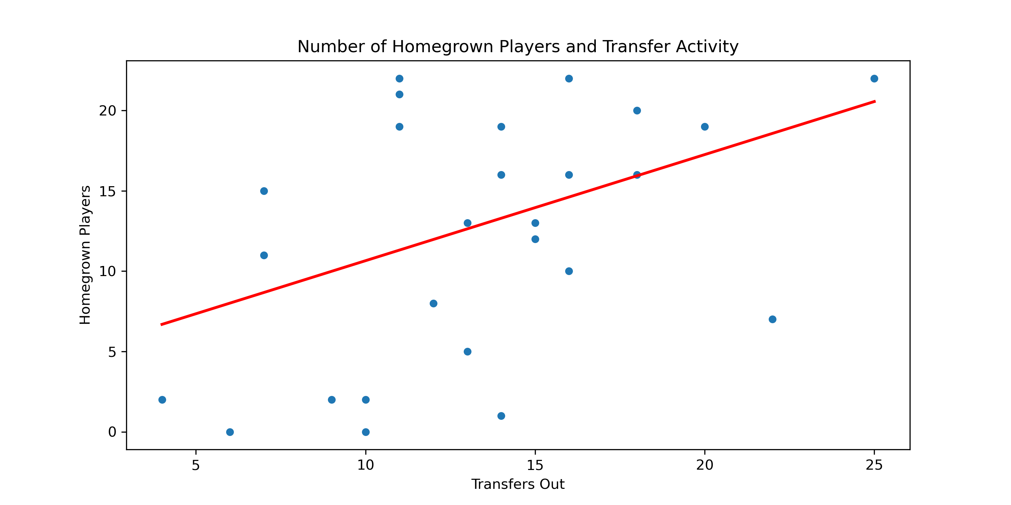
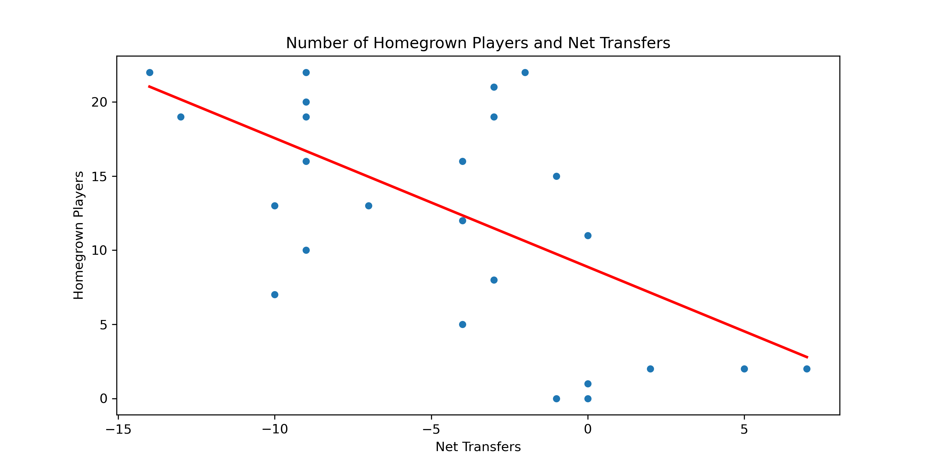
Transfer Activity and Homegrown Players

Slide 14

Model Performance
Linear Regression Model- prediction score: 0.994992063890612
For the Test Set-
The r2 of the model is: 0.995
The mean absolute error of the model is: 0.375
The mean squared error of the model is: 0.242
The root mean squared error of the model is: 0.492
For the Train Set-
The r2 of the model is: 0.996
The mean absolute error of the model is: 0.351
The mean squared error of the model is: 0.218
The root mean squared error of the model is: 0.467
KNN-Neighbours Test-
The r2 of the model is: 0.921

